Slide 1
Exercise 3
Introduction to E-Government
Group No. A6
Names : Sahil Ladola
Ravi Ramani
Jeel Katrodiya
Yash Nakrani

Slide 2
Agenda
Project Overview – ViDA (Cross-Border public service)
Main Functionalities
Media Breaks Analysis
One-Stop Government Concept
Life Events Concept
Back-End Integration
Conclusion & Recommendations

Slide 3

Project Overview – ViDA (Cross-Border public service)
Modernizing the VAT system in the EU to accommodate new technologies, diminish fraud, and ease business regulatory burdens, especially in cross-border trade and the platform economy, is Europe's Commission’s initiative referred to as VAT in the Digital Age (ViDA).
Focus on real-time reporting, platform economy, and single EU VAT registration
Online services provided :
Digital Reporting Requirements (DRR) and E-Invoicing
Platform Economy Reforms
Single VAT Registration
https://taxation-customs.ec.europa.eu/taxation/vat/vat-digital-age-vida_en#:~:text=On%208%20December%202022%2C%20the,development%20of%20the%20platform%20economy

Slide 4

Main Functionalities of the Proposal
Digital Reporting Requirements (DRR) for intra-EU B2B transactions
Platform economy rules for VAT liability (e.g., transport, accommodation)
Single EU VAT registration via OSS/IOSS
Standardized e-invoicing for cross-border trade
https://www.istockphoto.com/de/foto/scannen-von-fingerabdr%C3%BCcken-zur-sicherheitsauthentifizierung-mit-digitalen-symbolen-gm2196571988-614589522?utm_campaign=srp_photos_top&utm_content=https%3A%2F%2Funsplash.com%2Fs%2Fphotos%2FFunctionalities&utm_medium=affiliate&utm_source=unsplash&utm_term=Functionalities%3A%3A%3A

Slide 5

Media Breaks – Investigation
Current manual VAT processes and fragmented rules
Disconnected systems between tax bodies and digital platforms
ViDA aims for end-to-end digitalization
Reduces human dependency and enhances automation
https://www.google.com/url?sa=i&url=https%3A%2F%2Finstitute.aljazeera.net%2Fen%2Fajr%2Farticle%2Fwhat-open-source-investigation&psig=AOvVaw3eSYl2qDSomdS-kL5-lbhA&ust=1747586129092000&source=images&cd=vfe&opi=89978449&ved=0CBQQjRxqFwoTCLi79tP4qo0DFQAAAAAdAAAAABAE

Slide 6
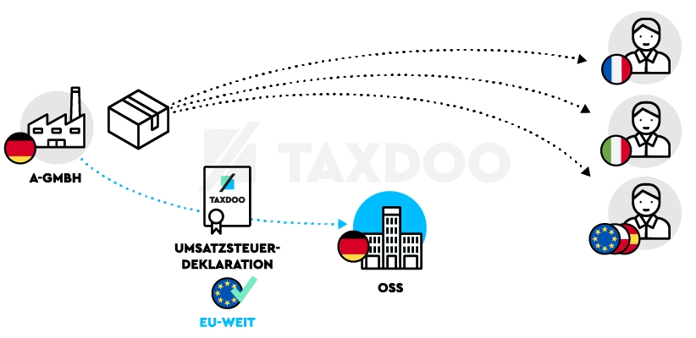
One-Stop Government Concept
Single digital access point for EU VAT compliance
OSS/IOSS expands to cover more goods/services
Eliminates need for multi-country VAT registrations
Strong alignment with One-Stop Government model
https://www.google.com/url?sa=i&url=https%3A%2F%2Fwww.gfm-nachrichten.de%2Fnews%2Fone-stop-shop-co-ohne-umsatzsteuersorgen-eu-weit-verkaufen%2F&psig=AOvVaw0i99S6k0Sqx59geJ5Mg7Up&ust=1747586637376000&source=images&cd=vfe&opi=89978449&ved=0CBQQjRxqFwoTCPDC-oL8qo0DFQAAAAAdAAAAABAE

Slide 7
Life Events Concept Implementation
Indirectly relevant to business life-cycle events:
Starting cross-border sales
Expanding digital platform use
Importing goods into EU
Supports business evolution in the digital economy

Slide 8
Back-End Integration & Networked Government
Real-time data sharing across EU tax authorities
Standardized e-invoice format for consistency
API integration with customs and platforms
Enables a networked VAT system across the EU

Slide 9
Conclusion
ViDA is a forward-thinking reform aligning VAT with digital practices
Key to real-time, borderless tax compliance in the EU

Slide 10
Reference
European Commission – VAT in the Digital Age (ViDA) Overview
https://taxation-customs.ec.europa.eu/taxation/vat/vat-digital-age-vida_en
Adoption of the VAT in the Digital Age Package
https://taxation-customs.ec.europa.eu/news/adoption-vat-digital-age-package-2025-03-11_en
VAT in the Digital Age – Final Report Volume 1 (PDF)
https://taxation-customs.ec.europa.eu/system/files/2022-12/VAT%20in%20the%20Digital%20Age_Final%20Report%20Volume%201.pdf
ViDA Factsheet (PDF)
https://taxation-customs.ec.europa.eu/system/files/2022-12/vida-factsheet-2022.pdf
European Commission Press Release on ViDA
https://ec.europa.eu/commission/presscorner/detail/en/ip_24_5666

Slide 11
Thank you for your attention !!!
Group No. A6
Names : Sahil Ladola
Ravi Ramani
Jeel Katrodiya
Yash Nakrani

